Slide 1
<CATALOG>
<Root ABLOCK>
<TOC ABLOCK>
<STRUC ABLOCK>
BC / GC
<TOC ABLOCK>
<STRUC ABLOCK>
BC / GC
refers
<TOC ABLOCK>
<STRUC ABLOCK>
(BC / GC)
refers to one or multiple TOC(s)
Each TOC refers to one or multiple structure(s)
Each Structure refers to one or multiple FC(s)
<MDX ABLOCK>
<FC ABLOCK>
<FSX ABLOCK>
<FC ABLOCK>
<FC ABLOCK>
<IMG ABLOCK>
Each FC refers to its content blocks

Slide 2
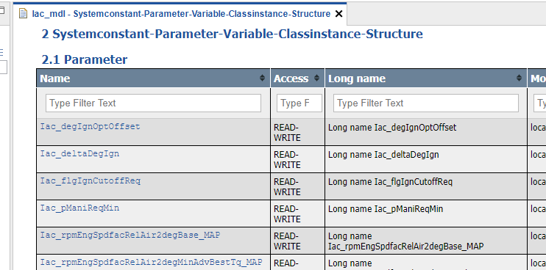
CCX
FC ABLOCK
<ABLOCK ID="ID_005000"> <!-- FC ABLOCK -->
<SHORT-NAME>Iac_mdl</SHORT-NAME>
<LONG-NAME>Ignition Angle Calculation</LONG-NAME>
<DESC>Iac - Ignition Angle Calculation</DESC>
<CATEGORY>FC</CATEGORY>
<AREFS>
<AREF ID-REF="ID_050011"/>
<AREF ID-REF="ID_050022"/>
<AREF ID-REF="ID_050033"/>
<AREF ID-REF="ID_050044"/>
</AREFS>
</ABLOCK>
MDX ABLOCK
MDX File
<ABLOCK ID="ID_050022"> <!-- MDX ABLOCK -->
<SHORT-NAME>iac_mdx</SHORT-NAME>
<CATEGORY>TDATA-S</CATEGORY>
<FILES>
<FILE TYPE="MDX">Iac_mdl\_doc\iac.mdx</FILE>
</FILES>
</ABLOCK>
<!-- SW-FEATURE Snippet from MDX -->
<SW-COMPONENT-SPEC>
<SW-COMPONENTS>
<SW-FEATURE>
<SHORT-NAME>Iac_mdl</SHORT-NAME>
<LONG-NAME>Feature Iac</LONG-NAME>
<CATEGORY>FCT</CATEGORY>
<SW-FEATURE-OWNED-ELEMENT-SETS>
Reference CCX to file location
Reference within CCX by <AREF>
Reference MDX to CCX by <SHORT-NAME>
Visualisation in EHB-NAV
Notes:
Referencing method between CCX and individual MDX

Slide 3
CCX
Root ABLOCK
<ABLOCK ID="EHB_Container"> <!-- Root ABLOCK -->
<SHORT-NAME>ehbContainer</SHORT-NAME>
<AREFS>
<AREF ID-REF="ID_00000">fcAlpha_axl</AREF>
<AREF ID-REF="ID_00001">TDATA-PRO</AREF>
<AREF ID-REF="ID_00002">fcAlpha_mdl</AREF>
<AREF ID-REF="ID_00003">architectureView_mdl</AREF>
<AREF ID-REF="ID_00004">globalCdfCdfx</AREF>
</AREFS>
</ABLOCK>
MDX ABLOCK
<ABLOCK ID="ID_00001"> <!-- MDX ABLOCK -->
<SHORT-NAME>pavastpro</SHORT-NAME>
<CATEGORY>TDATA-PRO</CATEGORY>
<FILES>
<FILE TYPE="MDX">_global\FlexEcu.xml</FILE>
</FILES>
</ABLOCK>
MDX File
<!-- SW-FEATURE Snippet from MDX -->
<SW-COMPONENT-SPEC>
<SW-COMPONENTS>
<SW-FEATURE>
<SHORT-NAME>Iac_mdl</SHORT-NAME>
<LONG-NAME>Feature Iac</LONG-NAME>
<CATEGORY>FCT</CATEGORY>
<SW-FEATURE-OWNED-ELEMENT-SETS>
FC ABLOCK
<ABLOCK ID="ID_005000"> <!-- FC ABLOCK -->
<SHORT-NAME>Iac_mdl</SHORT-NAME>
<LONG-NAME>Ignition Angle Calculation</LONG-NAME>
<DESC>Iac - Ignition Angle Calculation</DESC>
<CATEGORY>FC</CATEGORY>
<AREFS>
<AREF ID-REF="ID_050011"/>
<AREF ID-REF="ID_050033"/>
<AREF ID-REF="ID_050044"/>
</AREFS>
</ABLOCK>
Visualisation in EHB-NAV
Reference CCX to file location
Reference within CCX by <AREF>
Reference MDX to CCX by <SHORT-NAME>
Notes:
Referencing method between CCX and global MDX

Slide 4
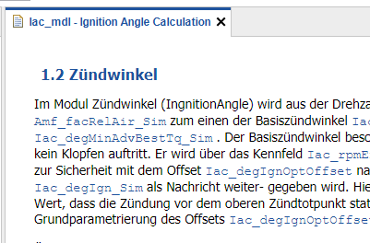
CCX
FC ABLOCK
<ABLOCK ID="ID_005000"> <!-- FC ABLOCK -->
<SHORT-NAME>Iac_mdl</SHORT-NAME>
<LONG-NAME>Ignition Angle Calculation</LONG-NAME>
<DESC>Iac - Ignition Angle Calculation</DESC>
<CATEGORY>FC</CATEGORY>
<AREFS>
<AREF ID-REF="ID_050011"/>
<AREF ID-REF="ID_050022"/>
<AREF ID-REF="ID_050033"/>
<AREF ID-REF="ID_050044"/>
</AREFS>
</ABLOCK>
FSX ABLOCK
FSX File
<ABLOCK ID="ID_050011"> <!-- FSX ABLOCK -->
<SHORT-NAME>iac_fsx</SHORT-NAME>
<CATEGORY>TDOC</CATEGORY>
<FILES>
<FILE TYPE="FSX">Iac_mdl\_doc\iac.fsx</FILE>
</FILES>
</ABLOCK>
<SW-COMPONENT-SPEC>
<SW-COMPONENTS>
<SW-FEATURE>
<SHORT-NAME></SHORT-NAME>
<LONG-NAME>
<L-4 L="EN">Ignition Angle Calculation</L-4>
</LONG-NAME>
<CATEGORY>FCT</CATEGORY>
<CHAPTER>
<LONG-NAME>Zündwinkel</LONG-NAME>
<P>
<L-1 L="DE">
Im Modul Zündwinkel (IngnitionAngle) re-
lativen Füllung <TT TYPE="VARIABLE">A
und zum anderen der optimale Zündwinkel
beschreibt den Winkel des Drehmoments,
auftritt. Er wird über das Kennfeld
</L-1>
</P>
Reference CCX to file location
Reference within CCX by <AREF>
Visualisation in EHB-NAV
Notes:
Referencing method between CCX and FSX

Slide 5

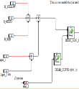

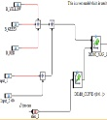

CCX
FC ABLOCK
<ABLOCK ID="ID_005000"> <!-- FC ABLOCK -->
<SHORT-NAME>Iac_mdl</SHORT-NAME>
<LONG-NAME>Ignition Angle Calculation</LONG-NAME>
<DESC>Iac - Ignition Angle Calculation</DESC>
<CATEGORY>FC</CATEGORY>
<AREFS>
<AREF ID-REF="ID_050011"/>
<AREF ID-REF="ID_050022"/>
<AREF ID-REF="ID_050033"/>
<AREF ID-REF="ID_050044"/>
</AREFS>
</ABLOCK>
Model ABLOCK
Model File
<ABLOCK ID="ID_050044"> <!-- Model ABLOCK -->
<SHORT-NAME>iac_mdl</SHORT-NAME>
<CATEGORY>MODEL</CATEGORY>
<FILES>
<FILE TYPE="MDL">Iac_mdl\Iac.mdl</FILE>
</FILES>
</ABLOCK>
Graphic ABLOCK
Image File
<ABLOCK ID="ID_050033"> <!-- Graphic ABLOCK -->
<SHORT-NAME>Iac_graph1</SHORT-NAME>
<CATEGORY>PIC-D</CATEGORY>
<FILES>
<FILE TYPE="JPG">Iac_mdl\_pic\iac_asSVG.svg</FILE>
</FILES>
</ABLOCK>
MDX ABLOCK
MDX File
<ABLOCK ID="ID_050022"> <!-- MDX ABLOCK -->
<SHORT-NAME>iac_mdx</SHORT-NAME>
<CATEGORY>TDATA-S</CATEGORY>
<FILES>
<FILE TYPE="MDX">Iac_mdl\_doc\iac.mdx</FILE>
</FILES>
</ABLOCK>
FSX ABLOCK
FSX File
<ABLOCK ID="ID_050011"> <!-- FSX ABLOCK -->
<SHORT-NAME>iac_fsx</SHORT-NAME>
<CATEGORY>TDOC</CATEGORY>
<FILES>
<FILE TYPE="FSX">Iac_mdl\_doc\iac.fsx</FILE>
</FILES>
</ABLOCK>
Reference CCX to file location
Reference within CCX by <AREF>
Notes:
Referencing method between CCX and external files

Slide 6
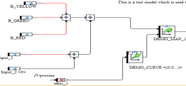
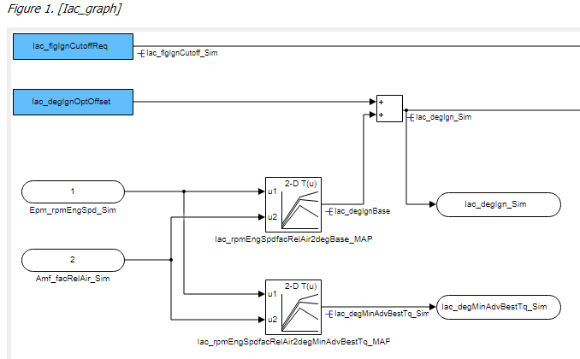
CCX
FC ABLOCK
<ABLOCK ID="ID_005000"> <!-- FC ABLOCK -->
<SHORT-NAME>Iac_mdl</SHORT-NAME>
<LONG-NAME>Ignition Angle Calculation</LONG-NAME>
<DESC>Iac - Ignition Angle Calculation</DESC>
<CATEGORY>FC</CATEGORY>
<AREFS>
<AREF ID-REF="ID_050011"/>
<AREF ID-REF="ID_050022"/>
<AREF ID-REF="ID_050033"/>
<AREF ID-REF="ID_050044"/>
</AREFS>
</ABLOCK>
Graphic ABLOCK
Image File
<ABLOCK ID="ID_050033"> <!-- Graphic ABLOCK -->
<SHORT-NAME>Iac_graph1</SHORT-NAME>
<CATEGORY>PIC-D</CATEGORY>
<FILES>
<FILE TYPE="JPG">Iac_mdl\_pic\iac_asSVG.svg</FILE>
</FILES>
</ABLOCK>
FSX ABLOCK
FSX File
<ABLOCK ID="ID_050011"> <!-- FSX ABLOCK -->
<SHORT-NAME>iac_fsx</SHORT-NAME>
<CATEGORY>TDOC</CATEGORY>
<FILES>
<FILE TYPE="FSX">Iac_mdl\_doc\iac.fsx</FILE>
</FILES>
</ABLOCK>
<FIGURE> <!-- Figure Snippet from FSX -->
<FIGURE-CAPTION>
<SHORT-NAME>Iac_graph1</SHORT-NAME>
<LONG-NAME>
<L-4 L="DE">Ingnition</L-4>
</LONG-NAME>
</FIGURE-CAPTION>
<L-GRAPHIC L="FOR-ALL">
<GRAPHIC NOTATION="SVG" SCALE="0.61">
</GRAPHIC>
</L-GRAPHIC>
</FIGURE>
Reference CCX to file location
Reference within CCX by <AREF>
Reference FSX to CCX by <SHORT-NAME>
Visualisation in EHB-NAV
Notes:
Static graphic

Slide 7

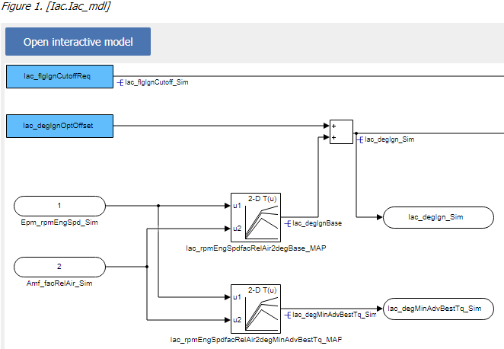
CCX
FC ABLOCK
<ABLOCK ID="ID_005000"> <!-- FC ABLOCK -->
<SHORT-NAME>Iac_mdl</SHORT-NAME>
<LONG-NAME>Ignition Angle Calculation</LONG-NAME>
<DESC>Iac - Ignition Angle Calculation</DESC>
<CATEGORY>FC</CATEGORY>
<AREFS>
<AREF ID-REF="ID_050011"/>
<AREF ID-REF="ID_050022"/>
<AREF ID-REF="ID_050033"/>
<AREF ID-REF="ID_050044"/>
</AREFS>
</ABLOCK>
Model ABLOCK
Model File
<ABLOCK ID="ID_050044"> <!-- Model ABLOCK -->
<SHORT-NAME>iac_mdl</SHORT-NAME>
<CATEGORY>MODEL</CATEGORY>
<FILES>
<FILE TYPE="MDL">Iac_mdl\Iac.mdl</FILE>
</FILES>
</ABLOCK>
Graphic ABLOCK
<ABLOCK ID="ID_050033"> <!-- Graphic ABLOCK -->
<SHORT-NAME>Iac_graph1</SHORT-NAME>
<CATEGORY>PIC-D</CATEGORY>
<SDGS>
<SDG GID="modeldata">
<SD GID="model">ID_050044</SD>
<SD GID="submodel-path">Iac/Iac_mdl</SD>
</SDG>
</SDGS>
<FILES>
<FILE TYPE="JPG">Iac_mdl\_pic\iac_asSVG.svg</FILE>
</FILES>
</ABLOCK>
Image File
FSX ABLOCK
FSX File
<ABLOCK ID="ID_050011"> <!-- FSX ABLOCK -->
<SHORT-NAME>iac_fsx</SHORT-NAME>
<CATEGORY>TDOC</CATEGORY>
<FILES>
<FILE TYPE="FSX">Iac_mdl\_doc\iac.fsx</FILE>
</FILES>
</ABLOCK>
<FIGURE> <!-- Figure Snippet from FSX -->
<FIGURE-CAPTION>
<SHORT-NAME>Iac_graph1</SHORT-NAME>
<LONG-NAME>
<L-4 L="DE">Ingnition</L-4>
</LONG-NAME>
</FIGURE-CAPTION>
<L-GRAPHIC L="FOR-ALL">
<GRAPHIC NOTATION="SVG" SCALE="0.61">
</GRAPHIC>
</L-GRAPHIC>
</FIGURE>
Reference CCX to file location
Reference within CCX by <SD GID>
Reference within CCX by <AREF>
Reference FSX to CCX by <SHORT-NAME>
Visualisation in EHB-NAV
Notes:
Link model with external graphic

Slide 8
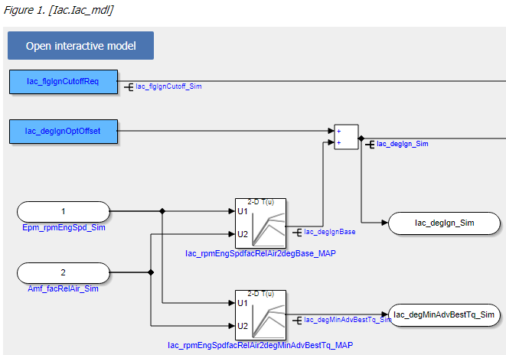
CCX
FC ABLOCK
<ABLOCK ID="ID_005000"> <!-- FC ABLOCK -->
<SHORT-NAME>Iac_mdl</SHORT-NAME>
<LONG-NAME>Ignition Angle Calculation</LONG-NAME>
<DESC>Iac - Ignition Angle Calculation</DESC>
<CATEGORY>FC</CATEGORY>
<AREFS>
<AREF ID-REF="ID_050011"/>
<AREF ID-REF="ID_050022"/>
<AREF ID-REF="ID_050033"/>
<AREF ID-REF="ID_050044"/>
</AREFS>
</ABLOCK>
Model ABLOCK
Model File
<ABLOCK ID="ID_050044"> <!-- Model ABLOCK -->
<SHORT-NAME>iac_mdl</SHORT-NAME>
<CATEGORY>MODEL</CATEGORY>
<FILES>
<FILE TYPE="MDL">Iac_mdl\Iac.mdl</FILE>
</FILES>
</ABLOCK>
FSX ABLOCK
FSX File
<ABLOCK ID="ID_050011"> <!-- FSX ABLOCK -->
<SHORT-NAME>iac_fsx</SHORT-NAME>
<CATEGORY>TDOC</CATEGORY>
<FILES>
<FILE TYPE="FSX">Iac_mdl\_doc\iac.fsx</FILE>
</FILES>
</ABLOCK>
<FIGURE> <!-- Figure Snippet from FSX -->
<FIGURE-CAPTION>
<SHORT-NAME>Iac.Iac_mdl</SHORT-NAME>
<LONG-NAME>
<L-4 L="DE">Ingnition</L-4>
</LONG-NAME>
</FIGURE-CAPTION>
<L-GRAPHIC L="FOR-ALL">
<GRAPHIC NOTATION="SVG" SCALE="0.61">
</GRAPHIC>
</L-GRAPHIC>
</FIGURE>
Reference CCX to file location
Reference within CCX by <AREF>
Model hierarchy path
Visualisation in EHB-NAV
Notes:
Link model with EHB graphic

Slide 9
VW: Link model with EHB graphic
CCX
FC ABLOCK
<ABLOCK ID="ID_005000"> <!-- FC ABLOCK -->
<SHORT-NAME>Iac_mdl</SHORT-NAME>
<LONG-NAME>Ignition Angle Calculation</LONG-NAME>
<DESC>Iac - Ignition Angle Calculation</DESC>
<CATEGORY>FC</CATEGORY>
<AREFS>
<AREF ID-REF="ID_050011"/>
<AREF ID-REF="ID_050044"/>
</AREFS>
</ABLOCK>
Model ABLOCK
Model File
<ABLOCK ID="ID_050044"> <!-- Model ABLOCK -->
<SHORT-NAME>iac_mdl</SHORT-NAME>
<CATEGORY>MODEL</CATEGORY>
<FILES>
<FILE TYPE="MDL">Iac_mdl\Iac.mdl</FILE>
</FILES>
</ABLOCK>
FSX ABLOCK
FSX File
<ABLOCK ID="ID_050011"> <!-- FSX ABLOCK -->
<SHORT-NAME>iac_fsx</SHORT-NAME>
<CATEGORY>TDOC</CATEGORY>
<FILES>
<FILE TYPE="FSX">Iac_mdl\_doc\iac.fsx</FILE>
</FILES>
</ABLOCK>
<FIGURE> <!-- Figure Snippet from FSX -->
<FIGURE-CAPTION>
<SHORT-NAME>Iac.Iac_mdl</SHORT-NAME>
<LONG-NAME>
<L-4 L="DE">Ingnition</L-4>
</LONG-NAME>
</FIGURE-CAPTION>
<L-GRAPHIC L="FOR-ALL">
<GRAPHIC NOTATION="SVG" SCALE="0.61">
</GRAPHIC>
</L-GRAPHIC>
</FIGURE>
Reference CCX to file location
Reference within CCX by <AREF>
Model hierarchy path
Visualisation in EHB-NAV

Slide 10
CCX
VW: Link model with EHB graphic
<!-- CCX ABLOCK for FC -->
<ABLOCK F-ID-CLASS="ABLOCK" ID="FEATBLK-EAA9493A-886C-4FC6-AE54-49753CE5FBA2" UPD="NEW" VIEW="PUBLIC">
<SHORT-NAME>VvlCord</SHORT-NAME>
<LONG-NAME>VvlCord</LONG-NAME>
<DESC>VvlCord - Request coordination for variable valve lift switching</DESC>
<CATEGORY>FC</CATEGORY>
<AREFS>
<AREF ID-REF="FSX_ID_0000000003">VvlCord_ID_0000000003</AREF>
<AREF ID-REF="AXL_ID_0000000004">VvlCord_ID_0000000004</AREF>
</AREFS>
</ABLOCK>
<!-- CCX ABLOCK for model -->
<ABLOCK ID="AXL_ID_0000000004">
<SHORT-NAME>VvlCord_ID_0000000004</SHORT-NAME>
<CATEGORY>MODEL</CATEGORY>
<FILES>
<FILE TYPE="AXL">..\Models\VvlCord\VvlCord_p.axl</FILE>
</FILES>
</ABLOCK>
<!-- CCX ABLOCK for FSX -->
<ABLOCK ID="FSX_ID_0000000003">
<SHORT-NAME>VvlCord_ID_0000000003</SHORT-NAME>
<CATEGORY>TDOC</CATEGORY>
<FILES>
<FILE TYPE="FSX">VvlCord/VvlCord.fsx</FILE>
</FILES>
</ABLOCK>
<!-- FSX chapter and Figure entry -->
<CHAPTER ID="CHA-13BB6A12-8AD7-4B37-A599-BA1E3C54395E" VIEW="PUBLIC" T="2015-10-29T15:46:49">
<SHORT-NAME>CHA-13BB6A12-8AD7-4B37-A599-BA1E3C54395E</SHORT-NAME>
<LONG-NAME>
<L-4 L="DE">01_01_Coordination_CDA</L-4>
</LONG-NAME>
<FIGURE>
<FIGURE-CAPTION ID="FIGAUTO62">
<SHORT-NAME>01_01_Coordination_CDA</SHORT-NAME>
<LONG-NAME>
<L-4 L="EN">01_01_Coordination_CDA</L-4>
</LONG-NAME>
</FIGURE-CAPTION>
<L-GRAPHIC L="FOR-ALL">
<GRAPHIC FILENAME="auto105.gif" NOTATION="gif" />
</L-GRAPHIC>
</FIGURE>
</CHAPTER>
<!-- FSX ModelRootWrapper entry -->
<SDG GID="HierarchyParser">
<SD GID="ModelRootWrapper">
<Name>VvlCord</Name>
<Hierarchies>
<Hierarchy
IsDiagram="false"
Name="01_01_04_Debounce_Switching_CDA"
picPath="D:\AVS\Doku\VvlCord\~VvlCord_2015_10_29_15_40_12\VvlCord\auto110.gif"
HierarchyPath="main/01_State_Coordination/01_01_Coordination_CDA/01_01_04_Debounce_Switching_CDA"
HierarchyLabel=""
FSXIDReference="CHA-B6F69664-56AF-413D-B70C-CE044D838C71"
OID="3613">
C:\eHandbook\Container\VW\Source20190502\Fehleranalyse\Verlinkungen_Eingangsdaten_CBTool\Container\~unzipped\VvlCord\VvlCord\VvlCord.fsx

Slide 11
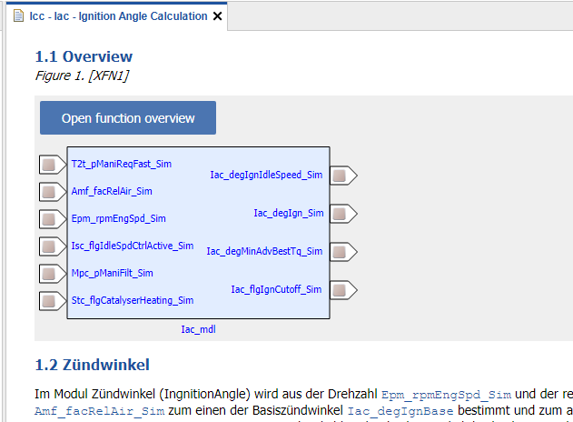
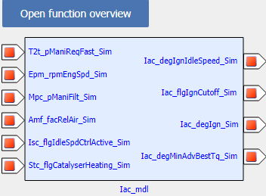
CCX
FC ABLOCK
<ABLOCK ID="ID_005000"> <!-- FC ABLOCK -->
<SHORT-NAME>Iac_mdl</SHORT-NAME>
<LONG-NAME>Ignition Angle Calculation</LONG-NAME>
<DESC>Iac - Ignition Angle Calculation</DESC>
<CATEGORY>FC</CATEGORY>
<AREFS>
<AREF ID-REF="ID_050011"/>
<AREF ID-REF="ID_050022"/>
<AREF ID-REF="ID_050033"/>
<AREF ID-REF="ID_050066"/>
</AREFS>
</ABLOCK>
MDX ABLOCK
<ABLOCK ID="ID_050022"> <!-- MDX ABLOCK -->
<SHORT-NAME>iac_mdx</SHORT-NAME>
<CATEGORY>TDATA-S</CATEGORY>
<FILES>
<FILE TYPE="MDX">Iac_mdl\_doc\iac.mdx</FILE>
</FILES>
</ABLOCK>
Function Overview ABLOCK
MDX File
<ABLOCK ID="ID_050066">
<SHORT-NAME>XFN1</SHORT-NAME>
<CATEGORY>PIC-FO</CATEGORY>
<SDGS>
<SDG GID="function_overview">
<SD GID="component">Iac_mdl</SD>
</SDG>
</SDGS>
</ABLOCK>
<!-- SW-FEATURE Snippet from MDX -->
<SW-COMPONENT-SPEC>
<SW-COMPONENTS>
<SW-FEATURE>
<SHORT-NAME>Iac_mdl</SHORT-NAME>
<LONG-NAME>Feature Iac</LONG-NAME>
<CATEGORY>FCT</CATEGORY>
<SW-FEATURE-OWNED-ELEMENT-SETS>
FSX ABLOCK
FSX File
<ABLOCK ID="ID_050011"> <!-- FSX ABLOCK -->
<SHORT-NAME>iac_fsx</SHORT-NAME>
<CATEGORY>TDOC</CATEGORY>
<FILES>
<FILE TYPE="FSX">Iac_mdl\_doc\iac.fsx</FILE>
</FILES>
</ABLOCK>
<FIGURE> <!-- Figure Snippet from FSX -->
<FIGURE-CAPTION>
<SHORT-NAME>XFN1</SHORT-NAME>
<LONG-NAME>
<L-4 L="DE">Ingnition</L-4>
</LONG-NAME>
</FIGURE-CAPTION>
<L-GRAPHIC L="FOR-ALL">
<GRAPHIC NOTATION="SVG" SCALE="0.61">
</GRAPHIC>
</L-GRAPHIC>
</FIGURE>
Visualisation in EHB-NAV
Reference CCX to file location
Reference CCX to MDX by <SD GID>
Reference within CCX by <AREF>
Reference FSX to CCX by <SHORT-NAME>
Notes:
Single Function Overview Graphic

Slide 12
CCX
FC ABLOCK
<ABLOCK ID="ID_005000"> <!-- FC ABLOCK -->
<SHORT-NAME>Iac_mdl</SHORT-NAME>
<LONG-NAME>Ignition Angle Calculation</LONG-NAME>
<DESC>Iac - Ignition Angle Calculation</DESC>
<CATEGORY>FC</CATEGORY>
<AREFS>
<AREF ID-REF="ID_050011"/>
<AREF ID-REF="ID_050022"/>
<AREF ID-REF="ID_050033"/>
<AREF ID-REF="ID_050066"/>
</AREFS>
</ABLOCK>
MDX File
<!-- SW-FEATURE Snippet from MDX -->
<SW-COMPONENT-SPEC>
<SW-COMPONENTS>
<SW-FEATURE>
<SHORT-NAME>Iac_mdl</SHORT-NAME>
...
<SW-FEATURE>
...
<SW-FEATURE>
<SHORT-NAME>Tqs_mdl</SHORT-NAME>
...
<SW-FEATURE>
...
<SW-FEATURE>
<SHORT-NAME>T2t_mdl</SHORT-NAME>
...
<SW-FEATURE>
Function Overview ABLOCK
<ABLOCK ID="ID_050066">
<SHORT-NAME>XFN1</SHORT-NAME>
<CATEGORY>PIC-FO</CATEGORY>
<SDGS>
<SDG GID="function_overview">
<SD GID="component">Iac_mdl</SD>
<SD GID="component">Tqs_mdl</SD>
<SD GID="component">T2t_mdl</SD>
</SDG>
</SDGS>
</ABLOCK>
FSX ABLOCK
FSX File
<ABLOCK ID="ID_050011"> <!-- FSX ABLOCK -->
<SHORT-NAME>iac_fsx</SHORT-NAME>
<CATEGORY>TDOC</CATEGORY>
<FILES>
<FILE TYPE="FSX">Iac_mdl\_doc\iac.fsx</FILE>
</FILES>
</ABLOCK>
<FIGURE> <!-- Figure Snippet from FSX -->
<FIGURE-CAPTION>
<SHORT-NAME>XFN1</SHORT-NAME>
<LONG-NAME>
<L-4 L="DE">Ingnition</L-4>
</LONG-NAME>
</FIGURE-CAPTION>
<L-GRAPHIC L="FOR-ALL">
<GRAPHIC NOTATION="SVG" SCALE="0.61">
</GRAPHIC>
</L-GRAPHIC>
</FIGURE>
Reference CCX to file location
Reference CCX to MDX by <SD GID>
Reference within CCX by <AREF>
Reference FSX to CCX by <SHORT-NAME>
Visualisation in EHB-NAV
Notes:
Cross Functions Overview Graphic

Slide 13
CCX File
<AREF ID-REF="EHB_Container" />
<ABLOCKS>
<ABLOCK ID="EHB_Container">
<SHORT-NAME>ehbContainer</SHORT-NAME>
<DESC />
<SDGS>
<SDG GID="global">
<SD GID="view">DETAILED</SD>
<SD GID="project_class">PVER</SD>
</SDG>
</SDGS>
<AREFS>
<AREF ID-REF="ID_00001">global_AUTOSAR_data</AREF>
<AREF ID-REF="ID_00000">fcAlpha_axl</AREF>
<AREF ID-REF="ID_00004">globalCdfCdfx</AREF>
</AREFS>
</ABLOCK>
Main ABLOCK for the EHB Container
ABLOCK with references to all software interface declarations, components, compositions (incl. connectors)
<ABLOCK ID="ID_00001">
<SHORT-NAME>Arxml_Ablock</SHORT-NAME>
<CATEGORY>SWCompo</CATEGORY>
<FILES>
<FILE TYPE="ARXML">_global_arxml\Compositions.arxml</FILE>
<FILE TYPE="ARXML">_global_arxml\Sensors_Comp.arxml</FILE>
<FILE TYPE="ARXML">_global_arxml\Actuators_Comp.arxml</FILE> </FILES>
</ABLOCK>

Slide 14
CCX File
<ABLOCK ID="ID_04000">
<SHORT-NAME>CPT_Afr</SHORT-NAME>
<LONG-NAME>Air Fuel Ratio</LONG-NAME>
<DESC>Afr - Air Fuel Ratio</DESC>
<CATEGORY>FC</CATEGORY>
<ADMIN-DATA>
<AREFS>
<AREF ID-REF="ID_04001" />
<AREF ID-REF="ID_04008" />
<AREF ID-REF="ID_04003" />
<AREF ID-REF="ID_04004" />
<AREF ID-REF="ID_04005" />
<AREF ID-REF="ID_04006" />
<AREF ID-REF="ID_04007" />
<AREF ID-REF="ID_04009" />
<AREF ID-REF="AfrXfn" />
</AREFS>
</ABLOCK>
ABLOCK with references to .arxml file(s)
for an individual SWC description
<ABLOCK ID="ID_04009">
<SHORT-NAME>afr_arxml</SHORT-NAME>
<CATEGORY>SWCD</CATEGORY>
<FILES>
<FILE TYPE="ARXML">Afr\Afr.arxml</FILE>
</FILES>
</ABLOCK>

